Slide 1
C Programming
Lecture 1

Slide 2
Content
Intro
Variables
Operators
Control statements
Functions
Scope
User input / output

Slide 3
Intro
Developed in 1969 ... 1973 by Dennis Ritchie at Bell Labs
Kernighan+ Ritchie "The C Programming Language" in 1987 (The K&R)
Influence on : csh, C++, C#, Java, JavaScript, Perl, PHP, python, ..
ANSI C : standard in 1989
American National Standards Institute
became known as C89

Slide 4
Intro
Current standard is ISO/IEC 9899:1999, or C99
GNU C = standard C + extensions (-stdoption)
compilers for any platform (OS and/or CPU)
C++ is extension of C
C is not strictly a subset of C++
but it is possible to write “Clean C” that conforms to both the C++ and C standards.

Slide 5
C programming
C library
Edit
hello.c
compile
hello.o
Link
hello
Source File
(High-Level Languages)
Object File
(Machine Languages)
_{Execute program} _{./hello}
nedit hello.c
gcc –o hello hello.c

Slide 6
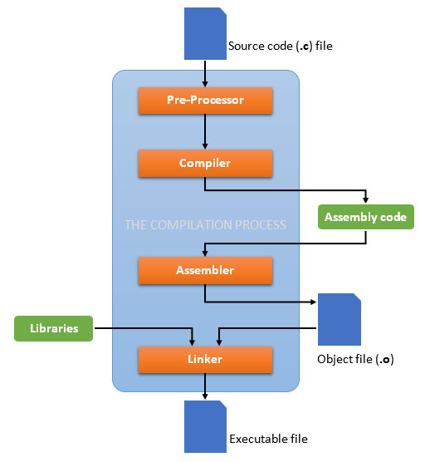
C programming
https://medium.com/@laura.derohan/compiling-c-files-with-gcc-step-by-step-8e78318052

Slide 7
Structure
There must be one main function where execution begins when the program is run. This function is called main
int main (void) { ... },
int main (int argc, char *argv[]) { ... }
additional local and external functions and variables

Slide 8
Body
#include <stdio.h>
/* My first C program */
int main()
{
printf(“Hello World!\n”);
exit(0);
}
preprocessor
comment
Function from stdio.h library
exit 0 indicates that program has been carried out without errors

Slide 9
Variables
type | Storage size in bytes*
char | 1
int | 2 or 4
short | 4
long | 4
float | 4
double | 8
Basic types :
integer, float, char
Void
No value
void pError (const int)
No return variable
int main (void)
Function without a parameter
Pointer types
Enumerated types
enum color {red, white, blue};
Composed types
Arrays, structures
* see next slide

Slide 10
Variables
Reserved space depends on compiler
Use sizeof()
Or use constant defined in limits.h, e.g. UCHAR_MAX = 255
Or use e.g. int16_t myVariable;
operator sizeof() returns the number of bytes to store the object (i.e. type of variabele)
printf("int=%d\n", sizeof(int));
_{int buffer[100];}
printf("buffer=%d\n", sizeof(buffer));

Slide 11
Constants / Enum / Typedef
#define PI 3.14 # preprocessor, find and replace
const float pi = 3.14; # obey’s scope, seen in debugger, part of the language
typedef enum {FALSE, TRUE} boolean;
boolean b;

Slide 12
Operators
arithmetical operators: +,-,*,/,%, ++, --
relational operators: >, >=,<,<=,==,!=
logical operators: &&, ||, !
bitwise operators: >>, <<, &, |, ~, ^
assignment operators: =, +=, -= etc.

Slide 13
Prefix and postfix
_{int i;}
_{char a[10] = "Jim";}
_{i=0;}
_{printf("%c\n", a[i++]);}
_{i=0;}
_{printf("%c\n", a[++i]);}
_{Output: J}
_{Output: i}

Slide 14
Control statements
if/else
return
switch/case/default
for (init; condition; loopincrement)
while (cond) {statements}
do { statements } while (condition)
_{#include <stdio.h>}
_{char c = 0;}
_{while ((c = getchar()) != EOF)}
{
_{/* do something with c */}
}

Slide 15
Functions
_{/* function prototype*/}
_{int maximum (int, int);}
_{int maximum (int x, int y)}
{
_{int max= x;}
_{.... statements ...}
_{return max;}
}
_{declaration}
_{header}
_{Block}
_{( = implementation)}

Slide 16
Function prototype
Function must be known in file before it can be used
function declaration = function prototype :
compiler can check on order and type of variables and return type
prevents run-time error
Forward declaration: function can be called before it is defined
can be made available for other files

Slide 17
Scope
What is printed?
_{file b.c:}
_{#include "a.h"}
_{int main()}
{
_{printf("%d\n", x);}
_{int i, x = 0;}
_{for (i=0; i < 1; i++) {}
_{int x = 3;}
_{a();}
_{printf("%d\n", x);}
}
_{return(0);}
}
_{file a.c:}
_{#include "a.h"}
_{int x = 5;}
_{void a()}
{
_{int x = 8;}
_{printf("%d\n", x);}
}
_{file a.h :}
_{#include <stdio.h>}
_{void a(void);}
_{extern int x;}
17
Notes:
Extern: scope is entire source code file (in example” a.h). Because this file is included in the others the scope of the external variable x is the complete program.
Hence x has value 5 at start of main function.
Within function a there is a local variable x
In for loop of main function again a local variable x is declared.
Only use extern when all or most program’s function need access to the variable, e.g. symbolic constants.

Slide 18
User input
#include <stdio.h>
int main()
{
int testInteger;
printf("Enter an integer: ");
scanf("%d", &testInteger);
printf("Number = %d",testInteger);
return 0;
}
char name[20];
scanf("%s",name);

Slide 19
Thies Keulen
Docent HBO-ICT h.t.keulen@pl.hanze.nl

